Slide 1
Java review – Chapters 1 through 9

Slide 2
Main Method
Every Java program must have at least one class. Each class has a name.
In order to run a class, the class must contain a method named main.
The program is executed from the main method.
// This program prints Welcome to Java!
public class Welcome {
public static void main(String[] args) {
System.out.println("Welcome to Java!");
}
}

Slide 3
Creating, Compiling, and Running Programs
Create a Java source code file and save with the .java extension.
And compile it into a .class file
The .class file is executed by the Java Virtual Machine (JVM)
Java Virtual Machine (JVM) is a software that interprets Java bytecode

Slide 4
Programming Errors
Syntax Errors
Detected by the compiler.
Mistype a keyword, omitting somethings
Runtime Errors
Causes the program to abort
Logic Errors
Produces incorrect result

Slide 5
Primitive Data Types in Java
char
byte
short
int
long
float
double
boolean
Java uses 4 types for integers, and uses 2 types for floating-point number

Slide 6
Numeric Operators

Slide 7
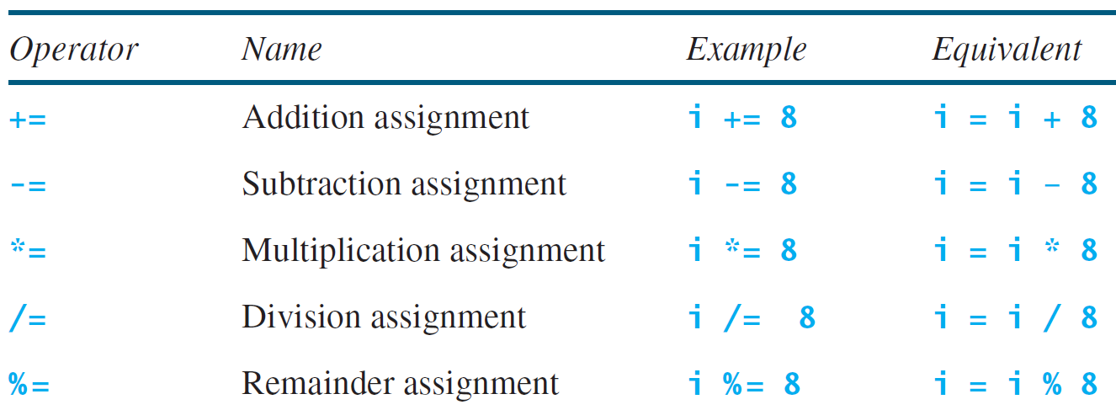
Augmented Assignment Operators (Combined Assignment operators)

Slide 8
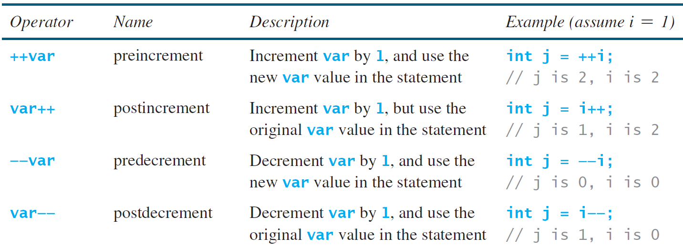
Increment and Decrement Operators

Slide 9
Increment and Decrement Operators , exercises.
What is the value of i and newNum?
int i = 10;
int newNum = 10 * i++
i = 11 newNum=100
What is the value of i and newNum?
int i = 10;
int newNum = 10 * ++i
i = 11 newNum=110

Slide 10
Relational Operators
Java provides six comparison operators that can be used to compare two values.
The result of the comparison is a Boolean value: true or false.

Slide 11
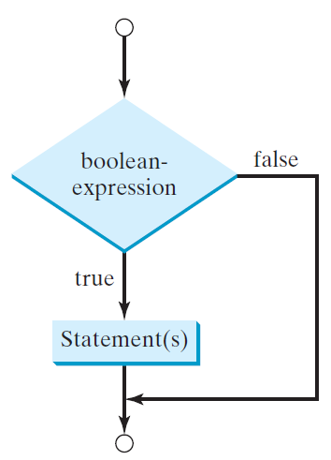
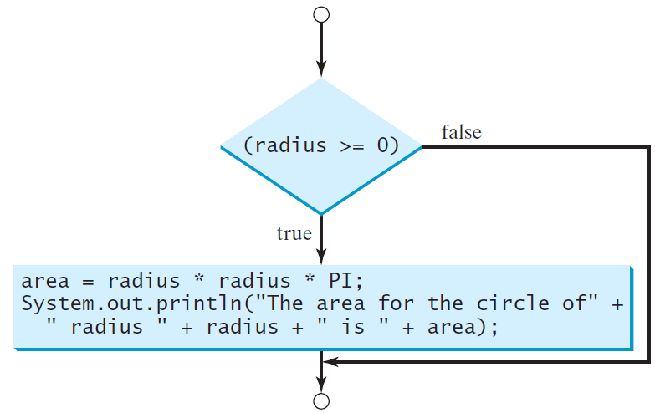
One-way if Statements
if (radius >= 0) {
area = radius * radius * PI;
System.out.println("The area"
+ " for the circle of radius "
+ radius + " is " + area);
}
if (boolean-expression) {
statement(s);
}

Slide 12
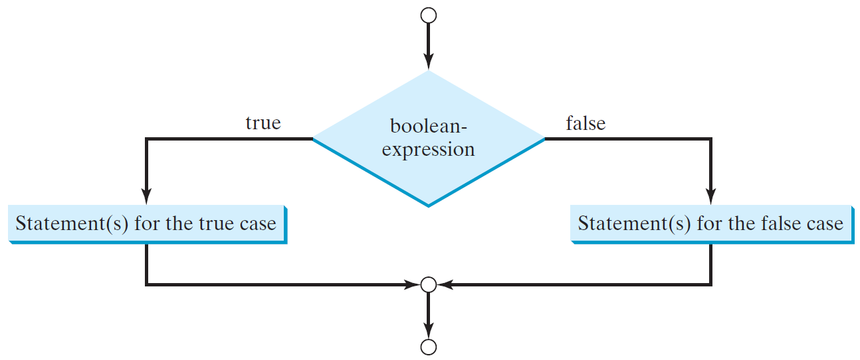
The Two-way if Statement
if (boolean-expression) {
statement(s)-for-the-true-case;
}
else {
statement(s)-for-the-false-case;
}

Slide 13
if-else Example
if (radius >= 0) {
area = radius * radius * 3.14159;
System.out.println("The area for the “
+ “circle of radius " + radius +
" is " + area);
}
else {
System.out.println("Negative input");
}

Slide 14
Multiple Alternative if Statements

Slide 15
Logical Operators
Operator | Name | Description
! | not | logical negation
&& | and | logical conjunction
|| | or | logical disjunction
^ | exclusive or | logical exclusion
xor

Slide 16
Exercise: Determining Leap Year?
To check if a year is a leap year.
A year is a leap year if it is divisible by 4 but not by 100, or it is divisible by 400.
How to write the statement using the logical operators?
(year % 4 == 0 && year % 100 != 0) || (year % 400 == 0)
// Check if the year is a leap year
boolean isLeapYear =
(year % 4 == 0 && year % 100 != 0) || (year % 400 == 0);

Slide 17
Conditional Operators
(boolean-expression) ? expression1 : expression2
if (x > 0)
y = 1
else
y = -1;
is equivalent to
y = (x > 0) ? 1 : -1;
What type of operator is the conditional operator?
Ternary operator
Binary operator
Unary operator

Slide 18
Conditional Operator
if (num % 2 == 0)
System.out.println(num + “is even”);
else
System.out.println(num + “is odd”);
Exercise: rewrite the statements using conditional operator
System.out.println(
(num % 2 == 0)? num + “is even” :
num + “is odd”);

Slide 19
Operator Precedence
var++, var--
+, - (Unary plus and minus), ++var,--var
(type) Casting
! (Not)
*, /, % (Multiplication, division, and remainder)
+, - (Binary addition and subtraction)
<, <=, >, >= (Relational operators)
==, !=; (Equality)
^ (Exclusive OR)
&& (Conditional AND) Short-circuit AND
|| (Conditional OR) Short-circuit OR
=, +=, -=, *=, /=, %= (Assignment operator)

Slide 20
Operator Precedence and Associativity
Parentheses is evaluated first.
Nested parentheses, the inner parentheses is executed first.
No parentheses, follow the precedence rule and the associativity rule.
Same level of precedence:
Use associativity rule
All binary operators except assignment operators are left-associative.
a – b + c – d equivalent ((a – b) + c) – d

Slide 21
Operator Associativity
Assignment operators are right-associative.
How to evaluate this?
(assume b=1)
a = b += c = 5
is equivalent to a = (b += (c = 5))
c=5
b +=5 -> b is 6
a=6

Slide 22
Mathematical Functions
Java provides many methods in the Math class for performing common mathematical functions.
Math class is in the java.lang package.
All the classes in the java.lang package are implicitly imported in a Java program.
Math.pow(2, 3) returns 8.0
Math.sqrt(4) returns 2.0
Math.max(2.5, 3) returns 3.0
Math.min(2.5, 3.6) returns 2.5
Math.abs(-2) returns 2
Math.abs(-2.1) returns 2.1

Slide 23
The random Method
Generates a random double value greater than or equal to 0.0 and less than 1.0 (0 <= Math.random() < 1.0).
Examples:
In general,

Slide 24
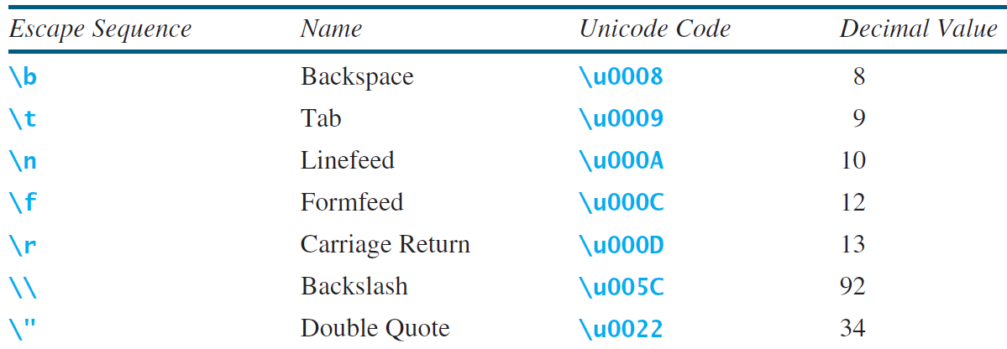
Escape Sequences for Special Characters
An escape sequence consists of a backslash ( \ ) followed
by a character or a combination of digits
The character \ is called the escape character

Slide 25
Escape Sequences for Special Characters
System.out.println(“He said \“ Java is fun \””);
The output is:
He said “ Java is fun ”

Slide 26
Comparing and Testing Characters
The Character class contains many methods for testing characters
The Character class is defined in the java.lang package

Slide 27
Methods in the Character Class

Slide 28
The String class
To represent a string of characters, use the data type called String.
String message = "Welcome to Java";
String is a predefined class in the Java library
The String type is not a primitive type. It is known as a reference type.
Any Java class can be used as a reference type for a variable.
message is a reference variable that references a string object with contents Welcome to Java

Slide 29
Simple Methods for String Objects

Slide 30
Comparing Strings
The String class has many methods for comparing two strings

Slide 31
Comparing Strings
How to compare the contents of 2 strings?
Use the equals method:
If (string1.equals(string2))
System.out.println(“S1 and S2 have the same contents”);
else
System.out.println(“S1 and S2 are not equal”);

Slide 32
Comparing Strings
“Welcome to Java”.startWith(“We”) return true
“Welcome to Java”.startWith(“we”) return false
“Welcome to Java”.endsWith(“va”) return true
“Welcome to Java”.endsWith(“v”) return false
“Welcome to Java”.contains(“t0”) return true
“Welcome to Java”.contains(“T0”) return false

Slide 33
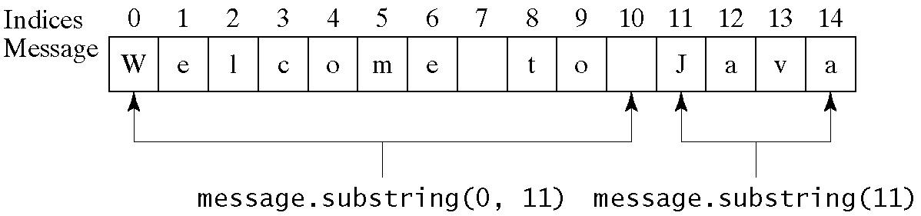
Obtaining Substrings

Slide 34
Finding a Character or a Substring in a String

Slide 35
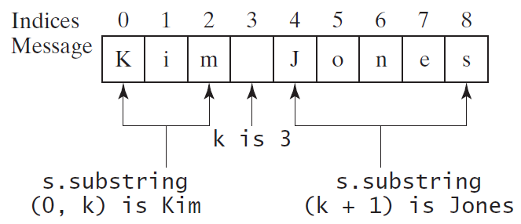
Finding a Character or a Substring in a String
string s contains the first name and last name separated by a space
How to extract first name and last name from the string?
int k = s.indexOf(' ');
String firstName = s.substring(0, k);
String lastName = s.substring(k + 1);

Slide 36
Formatting Output
Use the printf method to display formatted output on the console.
System.out.printf(format, items);
format is a string that consists of substrings and format specifiers.
A format specifier specifies how an item should be displayed.
An item may be a numeric value, character, boolean value, or a string.
Each specifier begins with a percent sign %.

Slide 37
Frequently-Used Specifiers
Specifier Output Example
%b a boolean value true or false
%c a character 'a'
%d a decimal integer 200
%f a floating-point number 45.460000
%e a number in standard scientific notation 4.556000e+01
%s a string "Java is cool"

Slide 38
Formatting Output
%10.2f
Output the floating-point item with width 10 including a decimal point and two digits after the point.
%12s
Output the string with width 12 characters. If the string item has fewer than 12 characters, add spaces before the string. If the string item has more than 12 characters, the width is automatically increased.

Slide 39
Formatting Output
If an item requires more spaces than the specified width, the width is automatically increased.
Execise:
System.out.printf("%3d#%2s#%4.2f\n", 1234, "Java", 51.6653);
displays
1234#Java#51.67

Slide 40

Formatting Output
By default, the output is right justified.
Use the minus sign (−) in the format specifier to specify that the item is left justified
right justify
System.out.printf("%8d%8s%8.1f\n", 1234, "Java", 5.63);
left justify
System.out.printf("%−8d%−8s%−8.1f \n", 1234, "Java", 5.63);
display

Slide 41
while Loops
int count = 0;
while (count < 100) {
System.out.println("Welcome to Java");
count++;
}

Slide 42
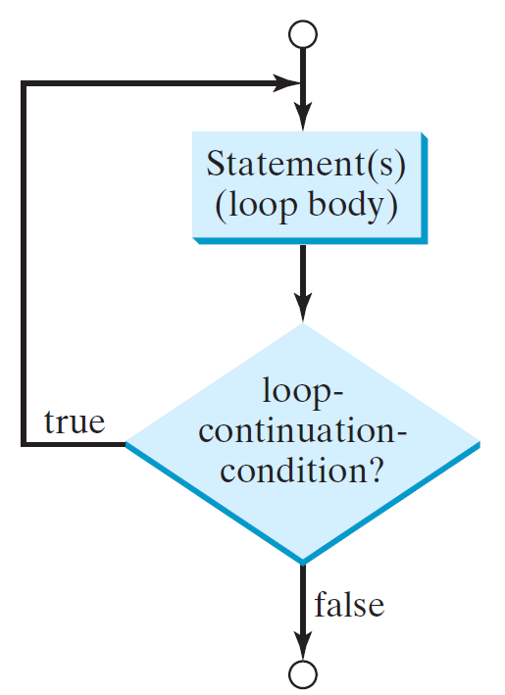
do-while Loop
do {
// Loop body;
Statement(s);
} while (loop-continuation-condition);

Slide 43
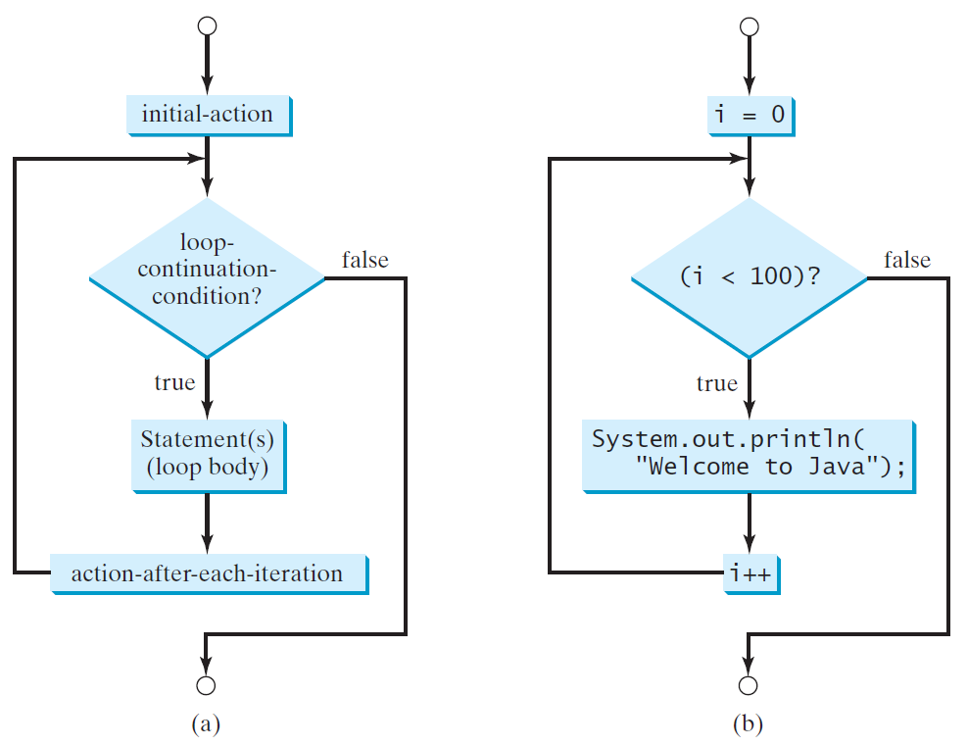
for Loops
for (initial-action; loop-continuation-condition; action-after-each-iteration){
// loop body;
Statement(s);
}
int i;
for (i = 0; i < 100; i++) {
System.out.println(
"Welcome to Java!");
}

Slide 44
Reading Input from the Console
How to accept input from user?
1. use the Scanner class, to create a Scanner object for console input
Java uses System.out to refer to the standard output device, and System.in to the standard input device
Scanner console = new Scanner(System.in);
Declares console - is a variable whose type is Scanner
Creates an object of the Scanner type
The whole line creates a Scanner object and assigns its reference to the variable console

Slide 45
Reading Input from the Console
An object may invoke its methods
2. Use the Scanner object’s nextDouble() method to obtain to a double value. For example,
System.out.print("Enter a double value: ");
Scanner console = new Scanner(System.in);
double number1 = console.nextDouble();
Reads a number from the keyboard and assigns the value to the variable number1

Slide 46
Reading Numbers from the Keyboard
Scanner console = new Scanner(System.in);
int value = console.nextInt();

Slide 47
Reading a String from the Console
Use the next() method to read a string from the console.
The next() method reads a string that ends with a whitespace character.
Use the nextLine() method to read an entire line of text.
The nextLine() methods reads a string that ends with the Enter key pressed

Slide 48
Reading a String from the Console
Scanner console = new Scanner(System.in);
System.out.print("Enter three words separated by spaces: ");
String s1 = console.next();
String s2 = console.next();
String s3 = console.next();
System.out.println("s1 is " + s1);
System.out.println("s2 is " + s2);
System.out.println("s3 is " + s3);

Slide 49
Reading a Character from the Console
Scanner console = new Scanner(System.in);
System.out.print("Enter a character: ");
String s = console.nextLine();
char ch = s.charAt(0);
System.out.println("The character entered is " + ch);

Slide 50
Specific Import and wildcard Import
The Scanner class is in the java.util package
The specific import specifies a single class in the import statement
import java.util.Scanner;
The wildcard import imports all the classes in a package by using the asterisk as the wildcard
import java.util.* ;
No performance difference

Slide 51
Named Constants
A named constant is an identifier that represents a permanent value
Declare a constant:
final datatype CONSTANTNAME = VALUE;
The word final is a Java keyword for declaring a constant
final double PI = 3.14159;
final int SIZE = 3;

Slide 52
Defining Methods
A method is a collection of statements that are grouped together to perform an operation.

Slide 53
Method Return Value Type
A method may return a value. The returnValueType is the data type of the value the method returns.
If the method does not return a value, the returnValueType is the keyword void.
Eg, the returnValueType in the main method is void.

Slide 54
Overloading Methods
Overloading methods enable you to define the methods with the same name as long as their parameter lists are different within one class.
/** Return the max between two double values */
public static double max(double num1, double num2) {
if (num1 > num2)
return num1;
else
return num2;
}
Overloading the max Method
/** Return the max between two int values */
public static int max(int num1, int num2) {
if (num1 > num2)
return num1;
else
return num2;
}

Slide 55
public class TestMethodOverloading {
public static void main(String[] args) {
// Invoke the max method with int parameters
System.out.println("The maximum between 3 and 4 is "
+ max(3, 4));
// Invoke the max method with the double parameters
System.out.println("The maximum between 3.0 and 5.4 is "
+ max(3.0, 5.4));
}
The maximum of 3 and 4 is 4
The maximum of 3.0 and 5.4 is 5.4

Slide 56
Declaring and Creating Array in One Step
Array is a data structure that represents a collection of the same types of data.
To use an array, we must declare a variable to reference the array and specify the array’s element type
elementType[] arrayRefVar = new elementType[arraySize];
double[] myList = new double[10];
create an array by using the new operator and assign its reference to the variable

Slide 57
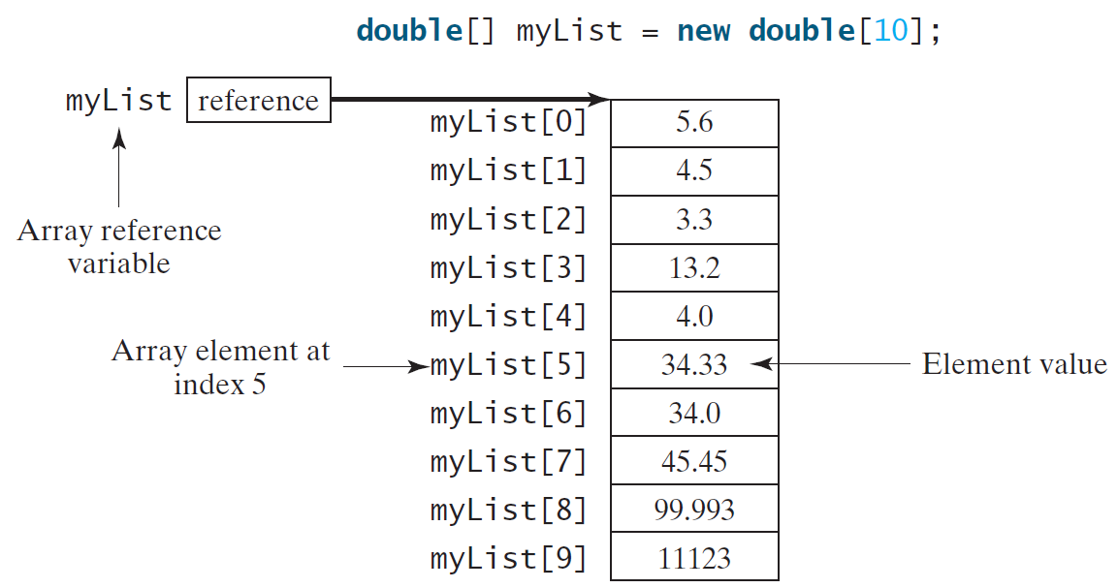
Arrays
To declare an array variable, myList, create an array of 10 elements of double type, and assigns its reference to myList.
To assign values to the element, use arrayRefVar[index] = value;
myList[0]=5.6;
myList[1]=4.5;
myList[2]=3.3;
…

Slide 58
The Length of an Array & Accessing Array Elements
Once an array is created, its size is fixed. It cannot be changed.
To find the array size
double[] myList = new double[10];
arrayRefVar.length
myList.length //returns 10
To find the last index:
ArrayRefVar.length-1
myList.length -1 //returns 9

Slide 59
Declaring, creating, initializing Using the Shorthand Notation
double[] myList = {1.9, 2.9, 3.4, 3.5};
equivalent
double[] myList = new double[4];
myList[0] = 1.9;
myList[1] = 2.9;
myList[2] = 3.4;
myList[3] = 3.5;
Using the shorthand notation, you have to declare, create, and initialize the array all in one statement.
Splitting it would cause a syntax error.
double[] myList;
myList = {1.9, 2.9, 3.4, 3.5};
//It is wrong:

Slide 60
Exercises
What is the output of the following code?
int x = 30;
int[] numbers = new int[x];
x = 60;
System.out.println("x is " + x);
System.out.println("The size of numbers is " + numbers.length);
Answer:
x is 60
The size of numbers is 30

Slide 61
Printing arrays- print each element in the array using a loop
for (int i = 0; i < myList.length; i++) {
System.out.print(myList[i] + " ");
}
Summing all elements
double total = 0;
for (int i = 0; i < myList.length; i++) {
total += myList[i];
}
Finding the largest element
double max = myList[0]; //varialbe max to store //the largest element
for (int i = 1; i < myList.length; i++) {
if (myList[i] > max) max = myList[i];
}
//compare each element with max, and update max if the element is greater than max

Slide 62
Enhanced for Loop (for-each loop)
Foreach loop enables to traverse the complete array sequentially without using an index variable.
the syntax is
for (elementType element: arrayRefVar) {
// Process the value
}
To displays all elements in the array myList:
for (double value: myList)
System.out.println(value);
to traverse the array in a different order or change the elements in the array, use an index variable.

Slide 63
Pass By Value vs Pass By Reference
For an argument of a primitive type, the argument value is passed.
For an argument of an array type, the value of the argument is a reference to an array; this reference is passed to the method.
Any changes to the array that occur inside the method body will affect the original array that was passed as the argument.
When a method returns an array, the reference of the array is returned

Slide 64
Simple Example
public class Test {
public static void main(String[] args) {
int x = 1; // x represents an int value
int[] y = new int[10]; // y represents an array of int values
m(x, y); // Invoke m with arguments x and y
System.out.println("x is " + x);
System.out.println("y[0] is " + y[0]);
}
public static void m(int number, int[] numbers) {
number = 1001; // Assign a new value to number
numbers[0] = 5555; // Assign a new value to numbers[0]
}
}
Output:
x is 1
y[0] is 5555

Slide 65
Declare/Create Two-dimensional Arrays
An element in a 2 dimensional array is accessed through a row and a column index
// Combine declaration and creation in one statement
elementType[][] arrayRefVar = new elementType[10][10];
int[][] matrix = new int[5][5];

Slide 66
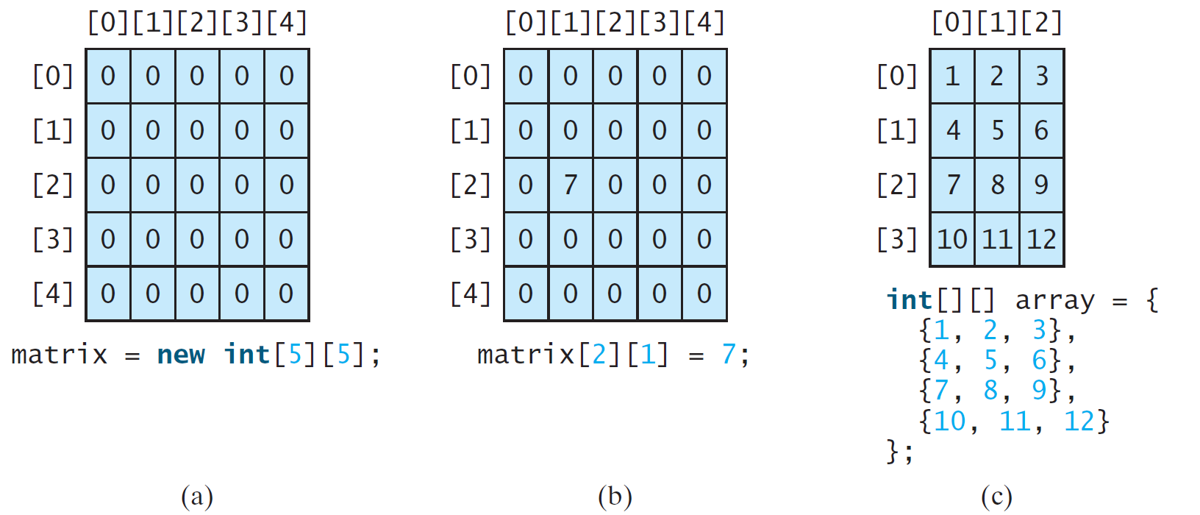
Two-dimensional Array Illustration

Slide 67
Declaring, Creating, and Initializing Using Shorthand Notations
Use an array initializer to declare, create and initialize a two-dimensional array.
int[][] array = {
{1, 2, 3},
{4, 5, 6},
{7, 8, 9},
{10, 11, 12}
};
int[][] array = new int[4][3];
array[0][0] = 1; array[0][1] = 2; array[0][2] = 3;
array[1][0] = 4; array[1][1] = 5; array[1][2] = 6;
array[2][0] = 7; array[2][1] = 8; array[2][2] = 9;
array[3][0] = 10; array[3][1] = 11; array[3][2] = 12;
Same as

Slide 68
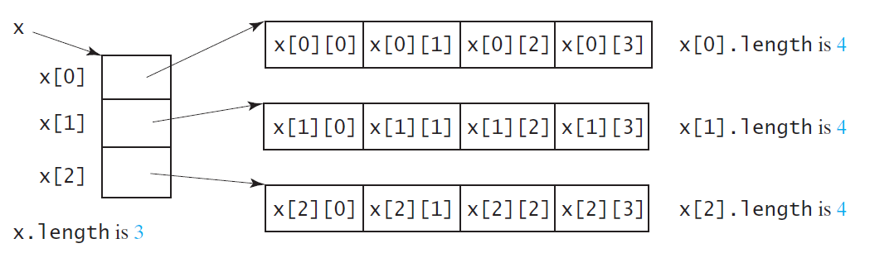
Lengths of Two-dimensional Arrays
int[][] x = new int[3][4];

Slide 69
Two-dimensional Array Illustration
matrix.length?
5
matrix[0].length?
5
array.length?
4
array[0].length?
3

Slide 70
Ragged Arrays
Each row in a two-dimensional array is itself an array. So, the rows can have different lengths. Such an array is known as a ragged array. For example,
int[][] matrix = {
{1, 2, 3, 4, 5},
{2, 3, 4, 5},
{3, 4, 5},
{4, 5},
{5}
};
matrix.length is 5
matrix[0].length is 5
matrix[1].length is 4
matrix[2].length is 3
matrix[3].length is 2
matrix[4].length is 1

Slide 71
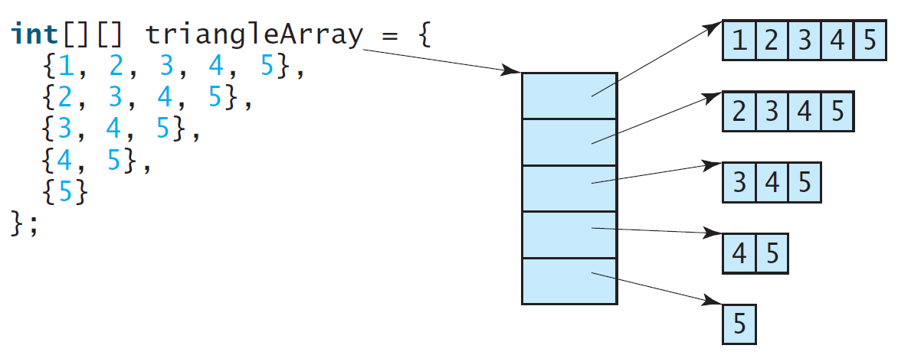
Ragged Arrays, cont.

Slide 72
Initializing arrays with input values
Nested for loops are often used to process a two dimensional array
Array matrix is created as follow:
int[][] matrix = new int[10][10];
java.util.Scanner console = new Scanner(System.in);
System.out.println("Enter " + matrix.length + " rows and " +
matrix[0].length + " columns: ");
for (int row = 0; row < matrix.length; row++) {
for (int column = 0; column < matrix[row].length; column++) {
matrix[row][column] = console.nextInt();
}
}

Slide 73
Printing arrays
for (int row = 0; row < matrix.length; row++) {
for (int column = 0; column < matrix[row].length; column++) {
System.out.print(matrix[row][column] + " ");
}
System.out.println();
}
Summing all elements
int total = 0;
for (int row = 0; row < matrix.length; row++) {
for (int column = 0; column < matrix[row].length; column++) {
total += matrix[row][column];
}
}

Slide 74
The Arrays class
Method name | Description
binarySearch(array, value) | returns the index of the given value in a sorted array (or < 0 if not found)
copyOf(array, length) | returns a new copy of an array
equals(array1, array2) | returns true if the two arrays contain same elements in the same order
fill(array, value) | sets every element to the given value
sort(array) | arranges the elements into sorted order
toString(array) | returns a string representing the array, such as "[10, 30, -25, 17]"
Class Arrays in package java.util has useful static methods for manipulating arrays:
Syntax: Arrays.methodName(parameters)

Slide 75
Arrays.toString
Arrays.toString accepts an array as a parameter and returns a String representation of its elements.
int[] e = {0, 2, 4, 6, 8};
e[1] = e[3] + e[4];
System.out.println("e is " + Arrays.toString(e));
Output:
e is [0, 14, 4, 6, 8]
Must import java.util.*;

